Slide 1
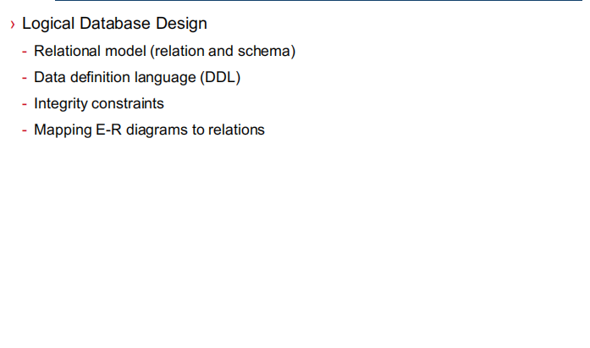
Outline of today

Slide 2
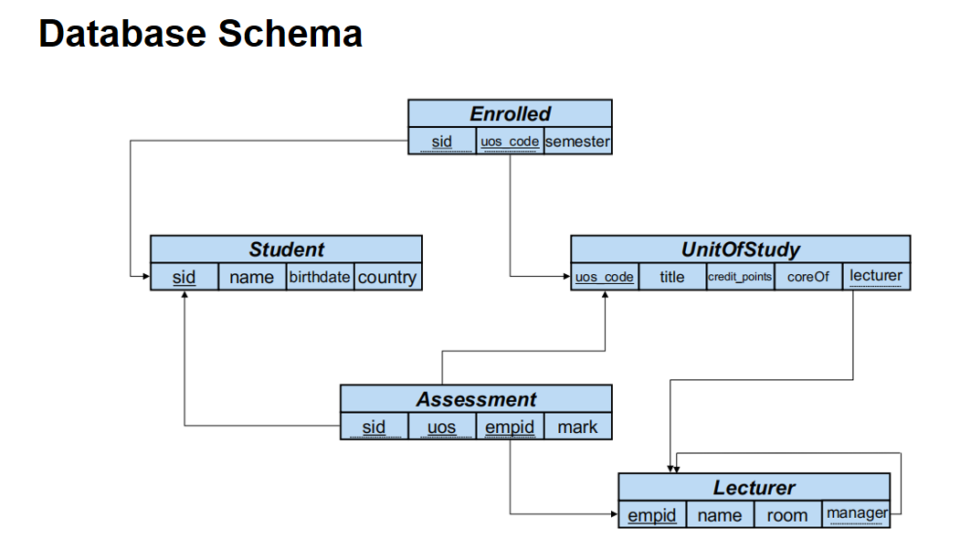

Slide 3
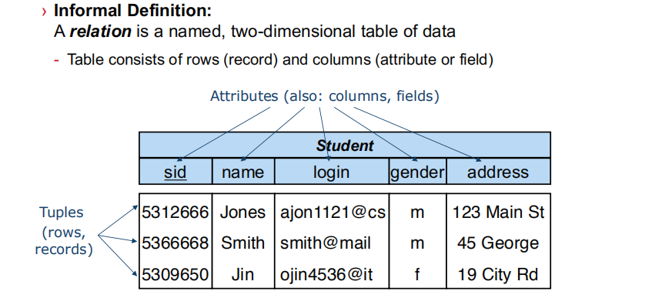

Slide 4
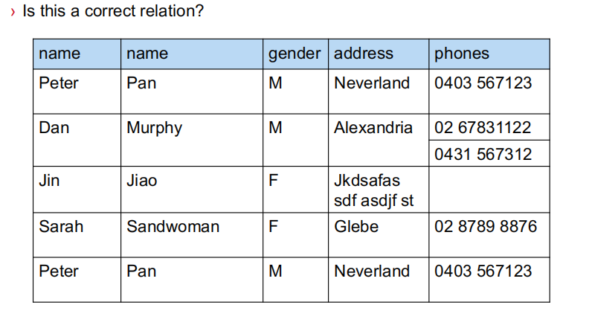
Not all tables qualify as a relation

Slide 5
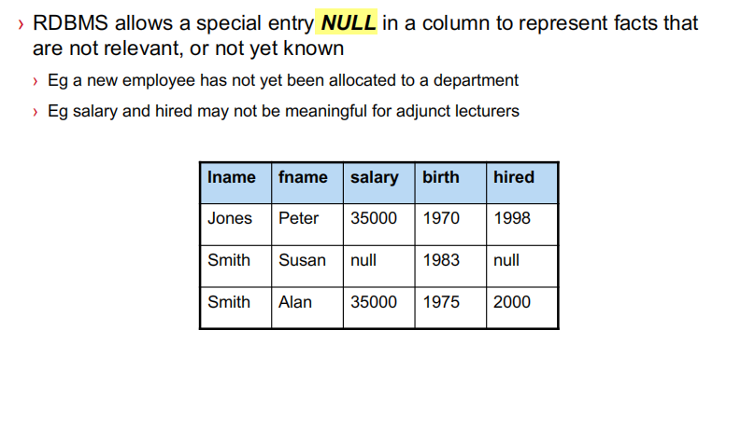
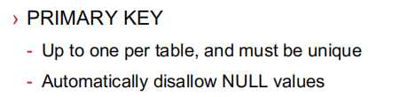

Slide 6
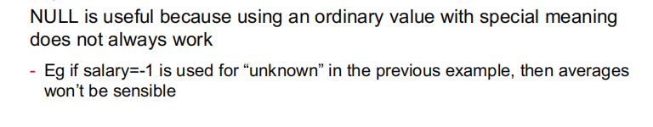
NULL值的优点
More details( NULL的用法):
https://blog.csdn.net/qq_38119877/article/details/108453420

Slide 7
Data Definition Language

Slide 8
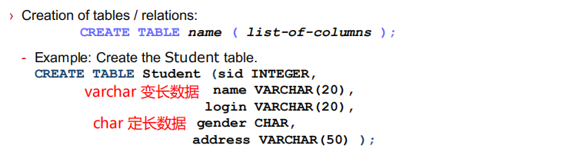
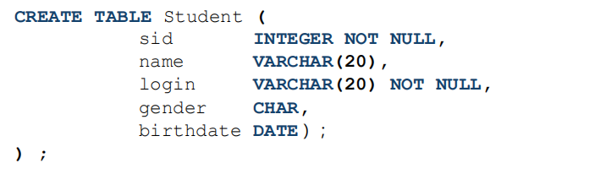
Not null constraint.

Slide 9
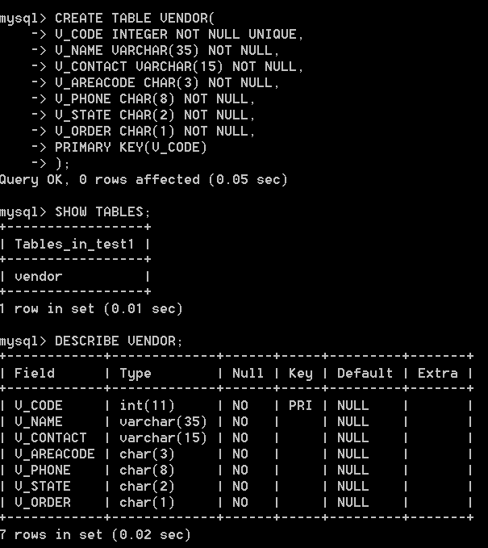
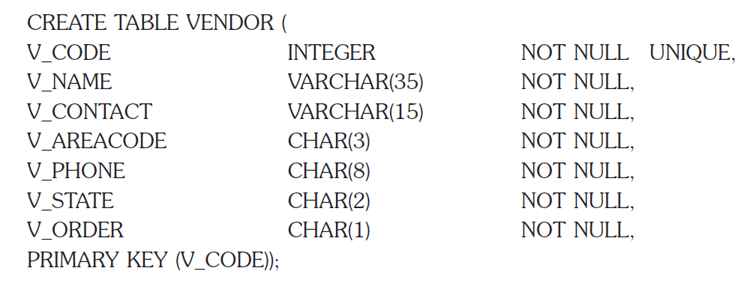
7.2.5 Creating table structures
Try these commands:
DESCRIBE [table name];
DROP TABLE [table name];
Notes:
CREATE TABLE VENDOR (
V_CODE INTEGER NOT NULL UNIQUE,
V_NAME VARCHAR(35) NOT NULL,
V_CONTACT VARCHAR(15) NOT NULL,
V_AREACODE CHAR(3) NOT NULL,
V_PHONE CHAR(8) NOT NULL,
V_STATE CHAR(2) NOT NULL,
V_ORDER CHAR(1) NOT NULL,
PRIMARY KEY (V_CODE));

Slide 10
Excercise (create a department table)
1、use school; 使用 school这个schema
属性名称 | 属性类型 | 非空约束 | 唯一约束
dept_id 系的编号，主码 | bigint | not null | unique
dept_name 系的名称 | varchar(50) | not null | unique
dept_student_num 系学生人数 | bigint | not null
director 系主任名字 | varchar(50) | not null

Slide 11
Excercise anwser (create a department table)
use school;
create table department (
dept_id bigint not null unique,
dept_name varchar(50) not null unique,
dept_student_num bigint not null,
director varchar(50) not null,
primary key(dept_name));

Slide 12
7.2.6 SQL Constraints
Entity integrity 实体完整性约束
Referential integrity 参照完整性约束
primary key(dept_id)
CONSTRAINT `S` FOREIGN KEY (`Sid`) REFERENCES `school`.`student table` (`Sid`)
ON DELETE CASCADE
ON UPDATE CASCADE
这里是外码约束的名称，可以为任意名称

Slide 13
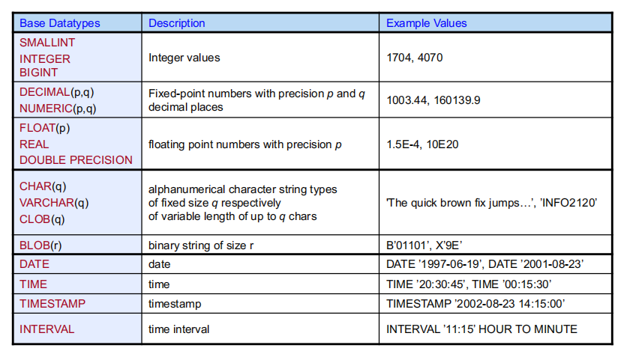

Slide 14
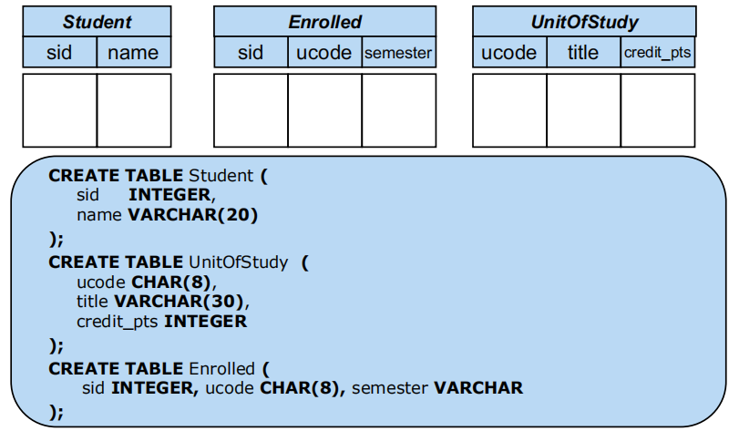

Slide 15
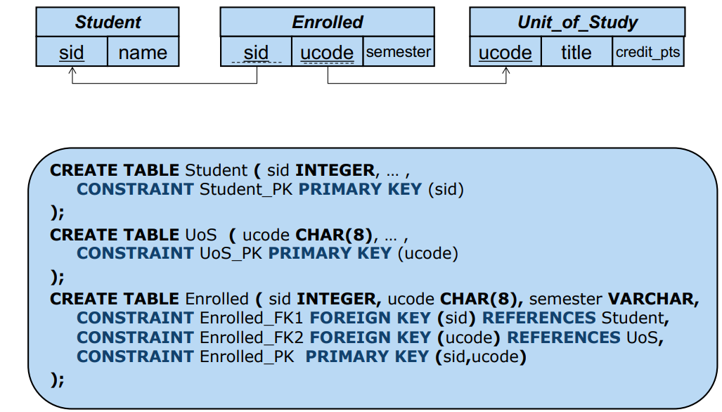

Slide 16
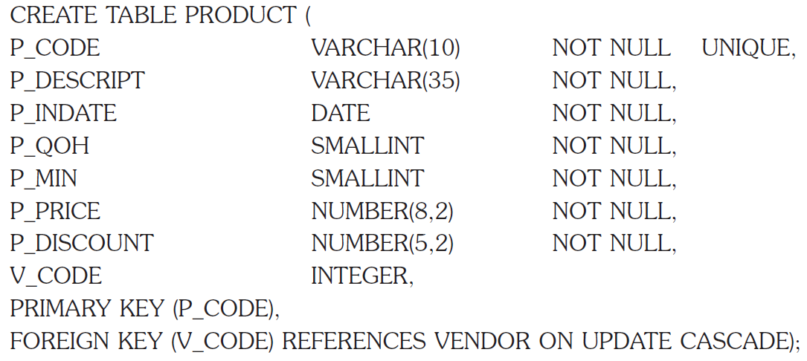
7.2.5 Creating table structures
Notes:
CREATE TABLE PRODUCT (
P_CODE VARCHAR(10) NOT NULL UNIQUE,
P_DESCRIPT VARCHAR(35) NOT NULL,
P_INDATE DATE NOT NULL,
P_QOH SMALLINT NOT NULL,
P_MIN SMALLINT NOT NULL,
P_PRICE DECIMAL(8,2) NOT NULL,
P_DISCOUNT DECIMAL(5,2) NOT NULL,
V_CODE INTEGER,
PRIMARY KEY (P_CODE),
FOREIGN KEY (V_CODE) REFERENCES VENDOR(V_CODE) ON UPDATE CASCADE
);

Slide 17
Excercise (create a Teacher table)
1、Teacher(Teacher_id, Teacher_name, Age, gender, dept_id)
属性名称 | 属性类型 | 非空约束 | 唯一约束
Teacher_id 老师的编号，主码 | bigint | not null | unique
Teacher_name 老师的名称 | varchar(50) | not null | unique
Age 老师年龄 | bigint | not null
gender 性别 | varchar(50) | not null
dept_id 老师所在的系编号（外码） | bigint | not null

Slide 18
Excercise (create a Teacher table)
2、增加外码约束，使老师所在系编号参照department表格的系编号
属性名称 | 属性类型 | 非空约束 | 唯一约束
Teacher_id 老师的编号，主码 | bigint | not null | unique
Teacher_name 老师的名称 | varchar(50) | not null | unique
Age 老师年龄 | bigint | not null
gender 性别 | varchar(50) | not null
dept_id 老师所在的系编号（外码） | bigint | not null

Slide 19
Data Definition Language
Drop table

Slide 20
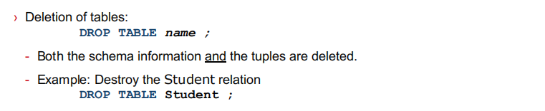
养成好习惯：建表之前先drop掉原来的表
Exercise:
Drop table teacher
(Drop table if exist)

Slide 21
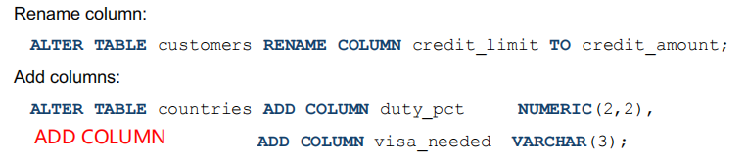
create table department (
dept_id bigint not null unique,
dept_name varchar(50) not null unique,
dept_student_num bigint not null,
director varchar(50) not null,
primary key(dept_name));
修改列名 / 增加列
DROP

Slide 22
Exercise
1、Rename the column name `dept_name` to `department_name`
2、在department表格，增加一列`lab_num`实验室数目，数据类型为bigint
3、Drop the column `lab_num`
DROP

Slide 23
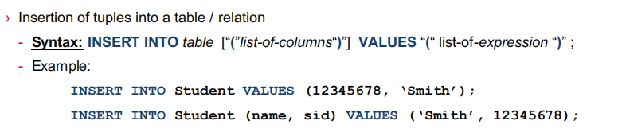
插入数值到元组
insert into department values (1,'software',50,'Li');

Slide 24
Exercise
insert data to department table
1、 Insert data (2,'E-commerce',50, 'Chen');
2、Insert data (3,'IT project management',50, 'Liu')

Slide 25
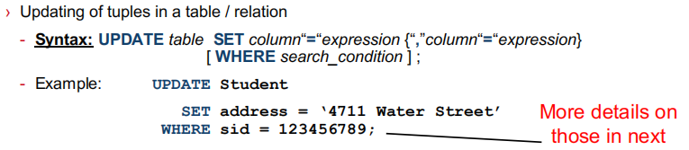
更新数值
update department
set dept_student_num = 60
where dept_name = 'software';

Slide 26
Exercise
Update the data in department table
1、 Update data as (2,'E-commerce',60, 'Chen');
2、Update data as (5,'IT project management',70, 'Liu')

Slide 27
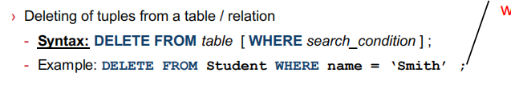
删除一行数值
delete from department where dept_name = 'IT project management';

Slide 28
Exercise
delete one row data from the enroll table
1、delete the data of (20202, 102, 86)

Slide 29
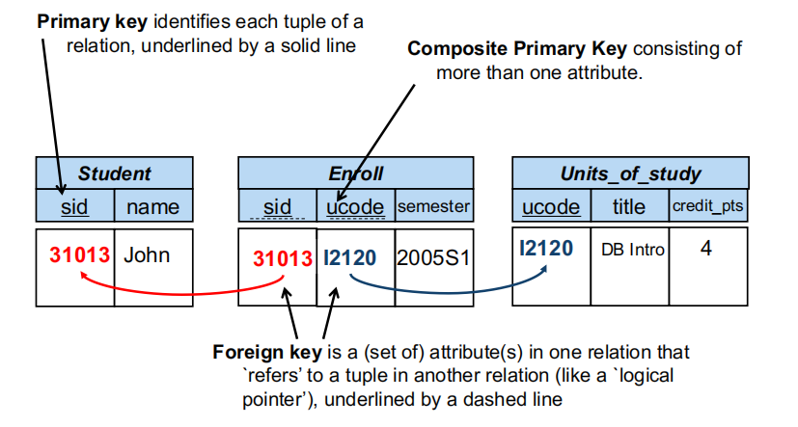
Foreign key(外码 虚线)
一个关系表内的属性，必须参考另一个关系的属性

Slide 30
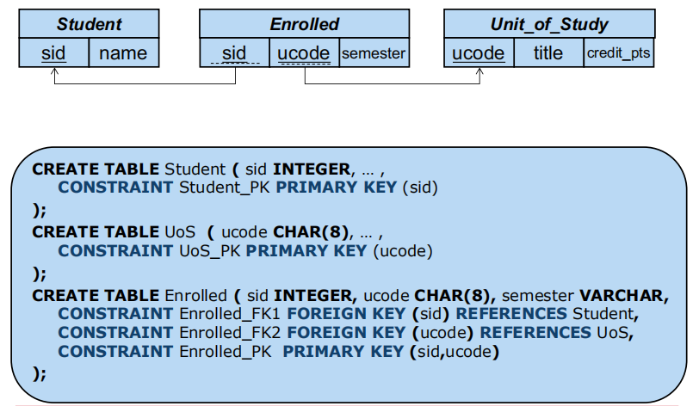

Slide 31
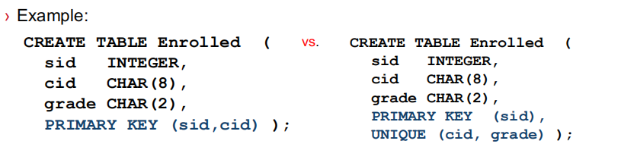
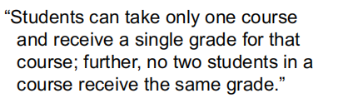
Exercise
这是多对多？一对多？多对一？一对一？

Slide 32
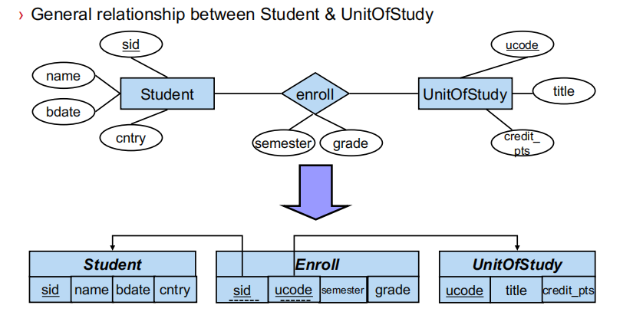
Mapping E-R Diagrams to Relations

Slide 33
Mapping E-R Diagrams to Relations
多 对 一
Each student can enroll in at most one course.
每个学生至多选择一门课。（一门课程可以被多个学生选择）
Sid | Name | bdate | cntry
Ucode | Semester | grade
ucode | title | credits

Slide 34
Mapping E-R Diagrams to Relations
一 对 一
每个学生都需要选择一门课。一门课程可以被多个或0个学生
Sid | Name | bdate | cntry
1 | Amy | 1998 | 2019
2 | Ben | 1999 | 2019
3 | Tom | 1998 | 2019
Ucode | Semester | grade
A01 | 1 | 90
A02 | 1 | 90
A03 | 1 | 90
ucode | title | credits

Slide 35
Mapping E-R Diagrams to Relations
一 对 一
每个学生都需要选择一门课。一门课程可以被多个或0个学生
Not null
Sid | Name | bdate | cntry
1 | Amy | 1998 | 2019
2 | Ben | 1999 | 2019
3 | Tom | 1998 | 2019
Ucode | Semester | grade
A01 | 1 | 90
A01 | 1 | 90
A03 | 1 | 90
ucode | title | credits

Slide 36
Mapping E-R Diagrams to Relations
Primary(Sid,ucode) Unique(sid, Ucode,semester)
unqiue(sid,ucode,grade)
unique(user, information)
每个学生都需要选择一门课。一门课程 只能被0个或1个学生选（至多被一个学生选）
Sid | Name | bdate | cntry
1 | Amy | 1998 | 2019
2 | Ben | 1999 | 2019
3 | Tom | 1998 | 2019
Ucode | Semester | grade
A01 | 1 | 90
A02 | 1 | 90
A03 | 1 | 90
ucode | title | credits
A100 | yuwen

Slide 37
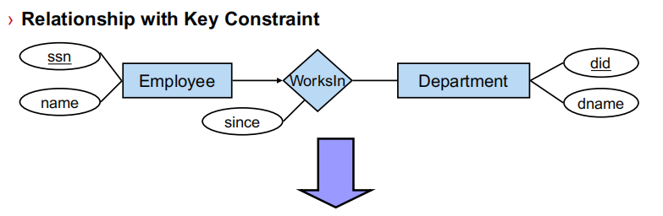
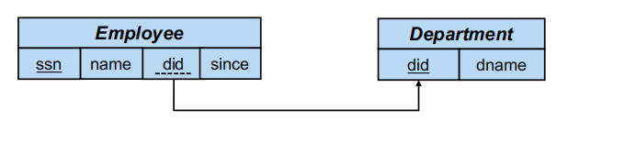
多 对 一
每个employee至多有一个departmnt。0或1
需要unique 或 not null？
1 | X | null
2 | Y | 1
3 | Z | 1

Slide 38
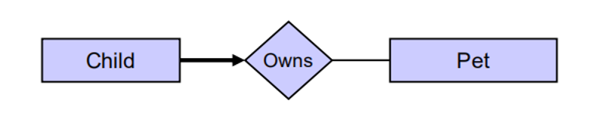
Exercise
细箭头
Child_ID
Name
Pet_ID
Price
每个小孩至多能拥有一只宠物
Child_ID | Name | Pet_ID

Slide 39
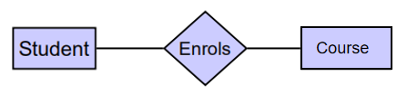
Exercise
细箭头
细箭头
SID
Name
Class
Course_ID
CourseName
Credits
Grade
每个学生至多能选一门课 一门课至多只能被一个学生选
Unique
Sid | Name | Class | CourseID | Grade
1 | Amy | 1 | A01
2 | Ben | 1 | A02
CourseID | C_Name | Credits | Sid | Grade

Slide 40
Exercise 5.7.1
1、 create schema enterprise 新建一个schema enterprise
2、create the employee(ssn,ename,did,since) and department(did,dname) tables. 创建员工表和部门表
3、Add unique and not null constraint on `did` of employee table.
4、insert 2 row of data into department table.
5、insert one row of data with null `did` value in table employee.
try the following code:
insert into employee values (202202,'Ken',002,null);
insert into employee values (202202,'Amy',003,'2022-03-05');

Slide 41
ALTER TABLE `enterprise`.`employee`
DROP FOREIGN KEY `did`;
ALTER TABLE `enterprise`.`employee`
ADD INDEX `did_idx` (`did` ASC) VISIBLE,
DROP INDEX `did` ;
;
ALTER TABLE `enterprise`.`employee`
ADD CONSTRAINT `did`
FOREIGN KEY (`did`)
REFERENCES `enterprise`.`department` (`did`)
ON DELETE CASCADE
ON UPDATE CASCADE;

Slide 42
Exercise 5.7.1
try the following code:
ALTER TABLE `enterprise`.`employee`
DROP INDEX `did` ;
insert into employee values (202205,'Abby',002,null);
insert into employee values (202206,'Terry',002,null);

Slide 43
Exercise
SID
Name
Class
Course_ID
CourseName
Credits
Grade
每个学生必须选一门课

Slide 44
Exercise
SID
Name
Class
Course_ID
CourseName
Credits
Grade
每个学生必须选一门课
每门课必须被一个学生选
CourseID | C_Name | credits | SID
Sid | Name | Class | Course_ID

Slide 45
Exercise
粗箭头
细箭头
SID
Name
Class
Course_ID
CourseName
Credits
Grade
每个学生必须选一门课
每门课至多被一个学生选

Slide 46
Thinking？
粗箭头
粗线
SID
Name
Class
Course_ID
CourseName
Credits
Grade
Sid | CourseID | Grade
每个学生必须选一门课
每门课至少被一个学生选
Sid | Name | Class | Course_ID

Slide 47
Thinking
SID
Name
Class
Grade
Course_ID
CourseName
Credits
Semester
每个学生在每学期至多修读一门课程

Slide 48
Thinking
SID
Name
Class
Grade
Course_ID
CourseName
Credits
Semester
每个学生在每学期至多修读一门课程，学生可以在不同学期修读同一门课程，但是学生修读同一门课程只能有一个成绩

Slide 49
Thinking
SID
Name
Class
Grade
Course_ID
CourseName
Credits
Semester
每个学生在每学期至多修读一门课程，且学生不能在不同的学期重复修读课程，即每个学生只能修读一次同一门课程。

Slide 50
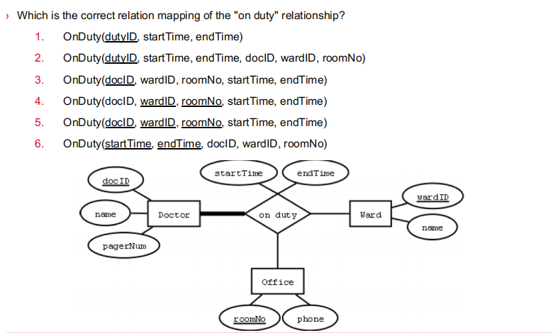
Exercise

Slide 51
SQL Indexes 索引
物理排序：基准属性为Sid, 行序号顺序按Sid从小到大排序
unique index SID=106 扫描两次就找到了
最多扫描4行 就一定能找到
Sid:105-108
Sid:101-104
行号row_id | 学号 Sid | 年龄 Age | 姓名 Name
904 | 105 | 35 | Amy
905 | 106 | 29 | Ben
906 | 107 | 30 | Candy
907 | 108 | 31 | Dean
行号row_id | 学号 Sid | 年龄 Age | 姓名 Name
900 | 101 | 20 | Amy
901 | 102 | 19 | Ben
902 | 103 | 19 | Candy
903 | 104 | 21 | Dean
Index: orderly arrangement to logically access rows in a table.
快速查找
索引的引入，除了有物理排序以外
还引入了逻辑排序
学号 Sid PK | 年龄 Age | 姓名 Name
101 | 20 | Amy
102 | 19 | Ben
103 | 19 | Candy
104 | 21 | Dean
105 | 35 | Amy
106 | 29 | Ben
107 | 30 | Candy
108 | 31 | Dean
create index `Index_on_Age` on student(`Age`)
索引页
Age=20 的所有行
Age:29-35
Age:19-21
create index on age 逻辑排序：基准属性为Age, 行序号顺序按Age从小到大排序
Index_on_Age | 行号Row_id | 年龄 Age
1 | 902 | 19
2 | 901 | 19
3 | 900 | 20
4 | 903 | 21
Index_on_Age | 行号Row_id | 年龄 Age
5 | 905 | 29
6 | 906 | 30
7 | 907 | 31
8 | 904 | 35

Slide 52
SQL Indexes 索引
Syntax:
CREATE [UNIQUE] INDEX indexname ON tablename(column1 [, column2]);
For example:
CREATE INDEX P_INDATEX ON PRODUCT(P_INDATE);
CREATE UNIQUE INDEX P_CODEX ON PRODUCT(P_COD);
Syntax:
DROP INDEX indexname;
For example:
DROP INDEX PROD_PRICEX;

